Slide 1
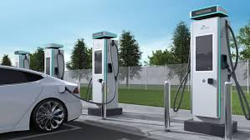
Charging the Way Forward:
Forecasting EV Growth and Connecting Underserved Areas
BAN 693 - Capstone Project
Presented by:
Adriel Naranjo
Prabhjot Gilard
Rachel Nguyen
Shahnaz Danesh

Slide 2
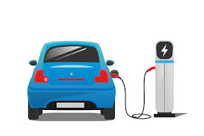
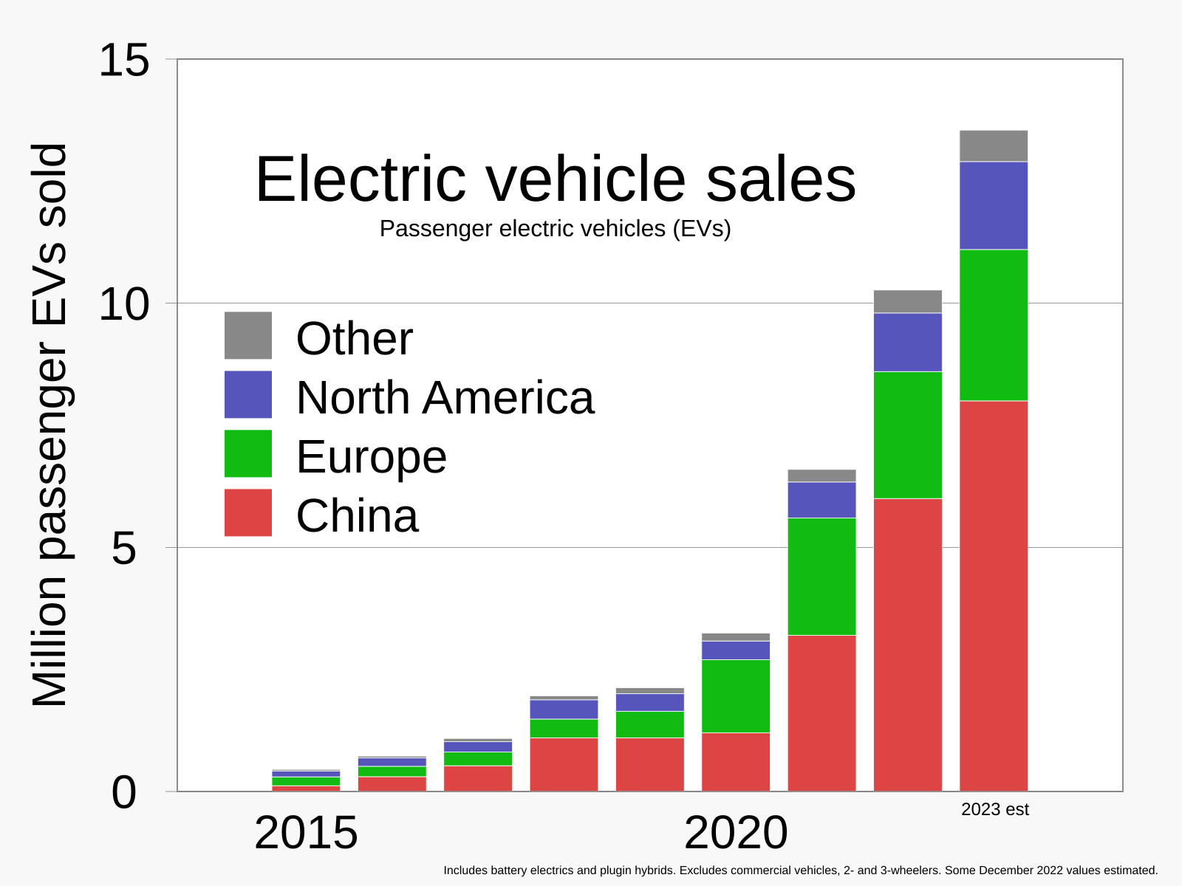
Introduction
Rising EV Adoption: Rapid growth in global EV ownership highlights the need for expanded infrastructure.
Infrastructure Gaps: Insufficient charging facilities in key areas risk unmet current and future demand.
Focus of the Project: Urban-rural disparities, infrastructure challenges, and strategies for equitable development.
Scalable, Nationwide Impact: Predictive model adaptable for optimizing EV infrastructure across the U.S.
Why Washington State? Robust data, diverse geography, and progressive policies.

Slide 3
Introduction
Objective:
To develop a predictive, data-driven solution for optimizing EV charging station placement in Washington State, addressing urban-rural disparities and ensuring equitable, efficient infrastructure to meet current and future demand.
Build an End-to-End ETL Pipeline
Develop a Tableau Dashboard for Strategic Planning
Identify Geographical Areas for New Charging Stations
Deliver a Reusable and Scalable Solution

Slide 4
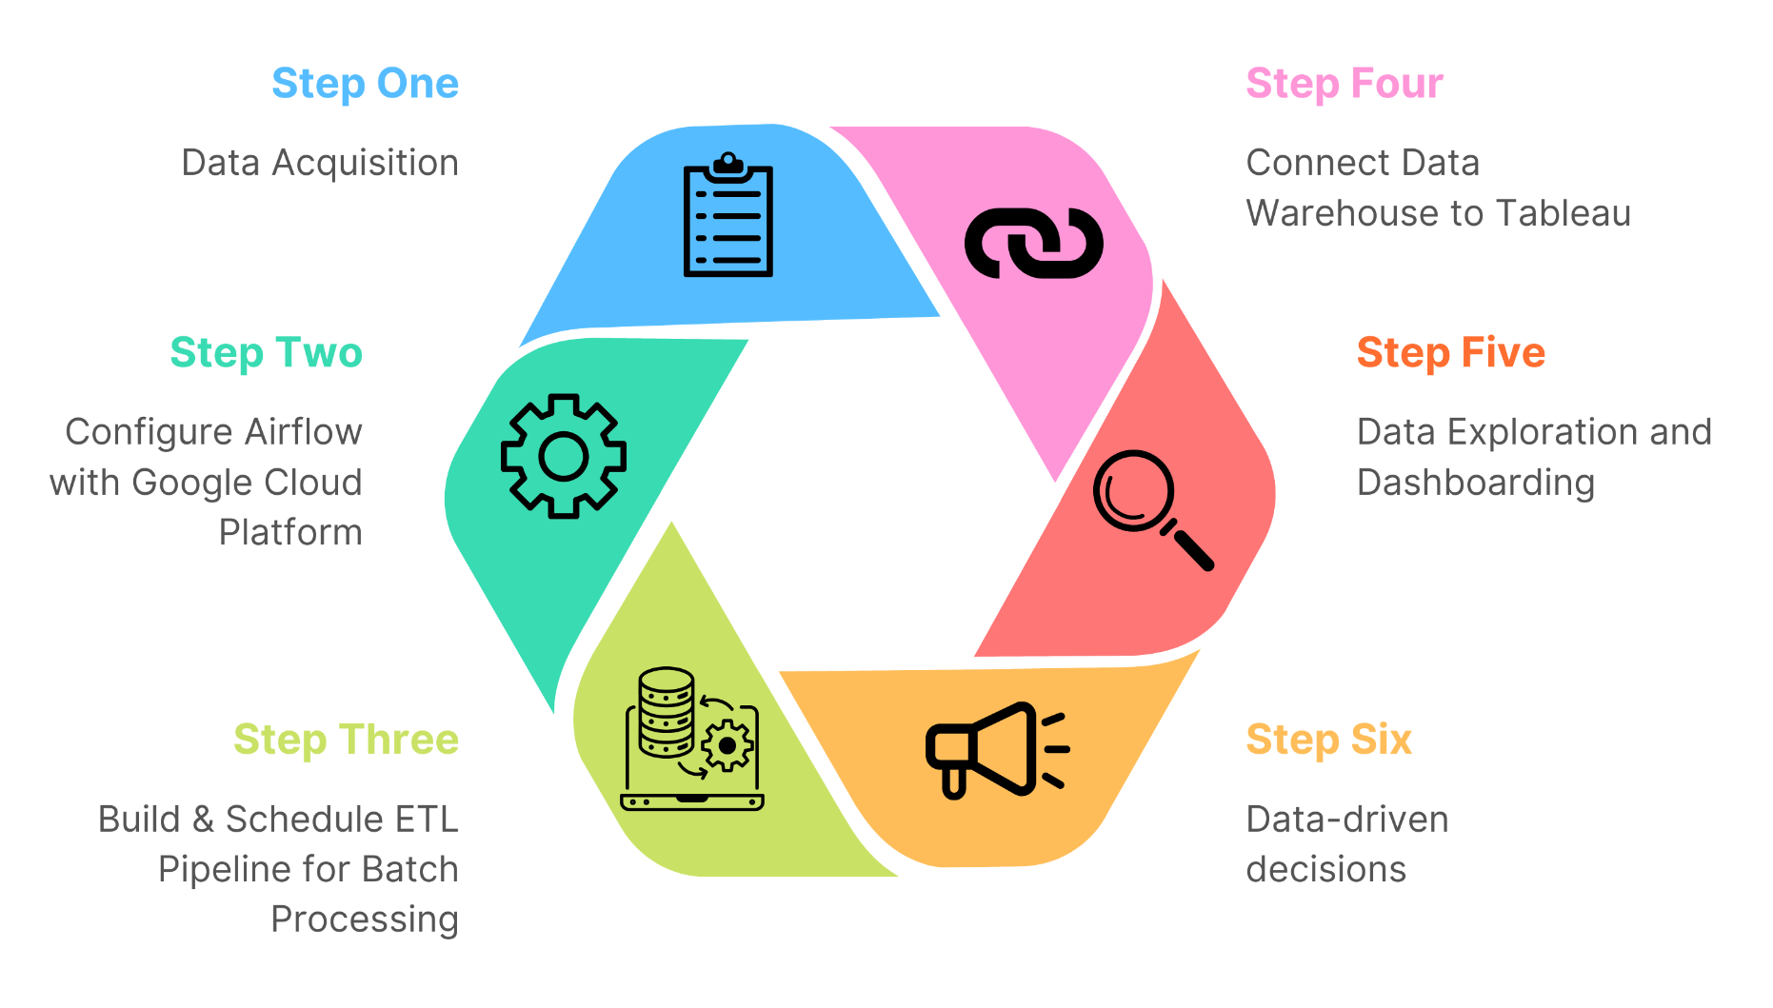
Methodology
Notes:
Ford Motor Co showcases a robust brand presence and innovative electric vehicle (EV) segment, Ford Model e.
Operational risks and supply chain vulnerabilities present significant challenges.
Emerging opportunities in the EV market and digital services could propel Ford ahead.
Competitive pressures and market dynamics remain a persistent threat.

Slide 5
Analysis
Hypothesis 1: Urban areas have significantly higher EV populations per charging station compared to rural areas.
Hypothesis 2: EV population growth aligns closely with the expansion of charging infrastructure, indicating a strong correlation.

Slide 6
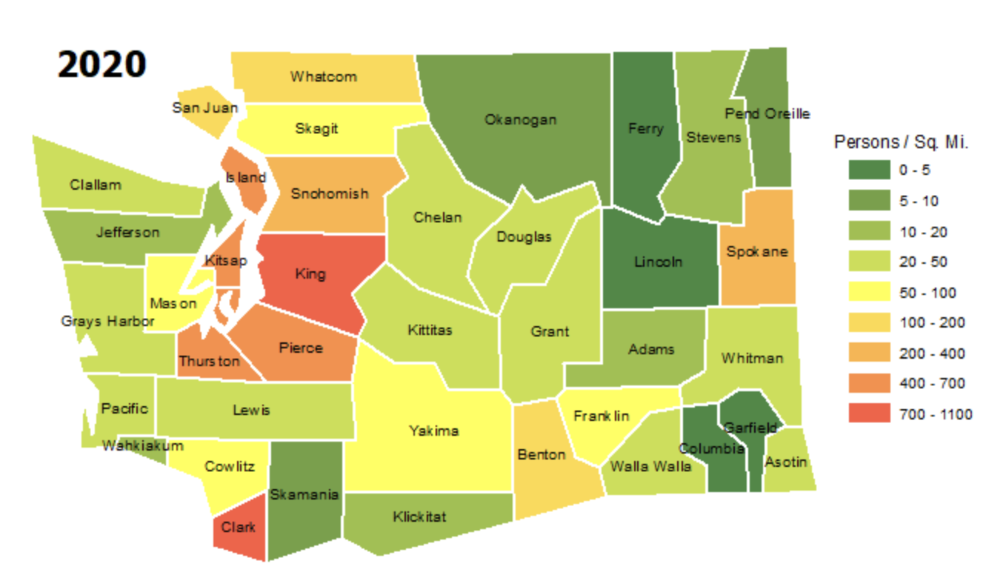
Analysis
Washington State Population Density:
Urban Concentration: King County, Pierce and Snohomish Counties, Clark County
Tech Hubs and Growth: Puget Sound Region (Amazon, Microsoft)
Rural and Low-Density Areas: Eastern Washington counties like Garfield, Columbia, and Ferry

Slide 7
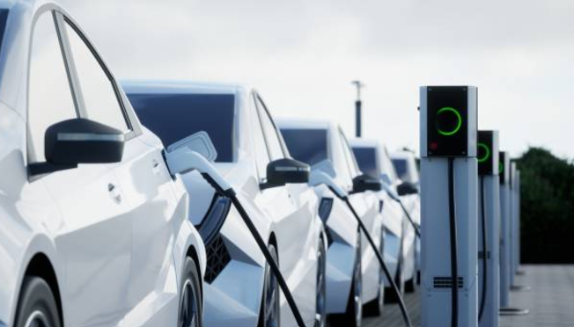
Analysis
Tableau Public Dashboard Link

Slide 8
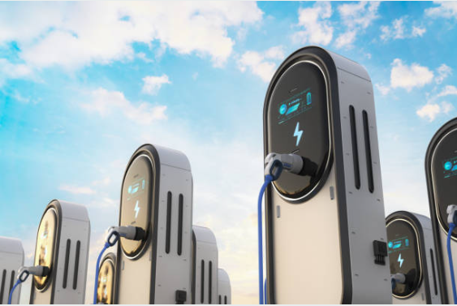
Takeaways
Unequal EV Adoption Across Washington State
Concentration in urban areas (e.g., King County); rural areas lag behind.
Highlights the need for tailored strategies to close infrastructure gaps.
Infrastructure Gaps in Underserved Regions
Disparities in EV-to-charging station ratios across counties.
Immediate focus needed in underserved areas.
Proactive Scaling in High-Adoption Counties
Urban counties like King and Pierce need proactive infrastructure scaling to meet growing EV ownership.
Rural areas require incentives for adoption and infrastructure development.

Slide 9
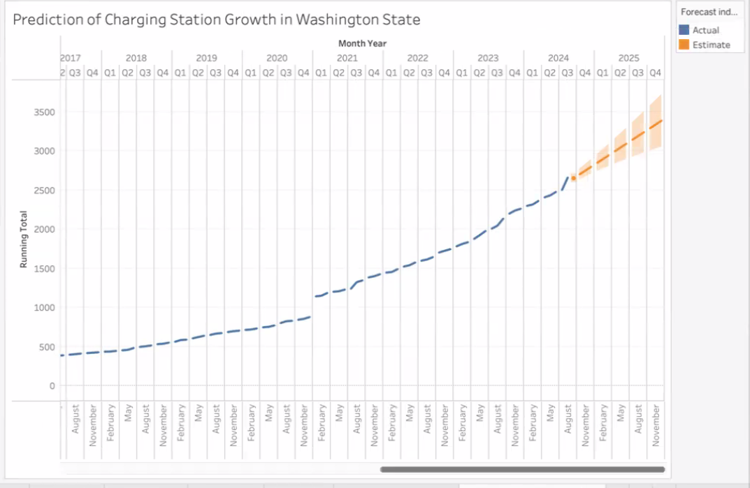
Recommendation I
Immediate and Targeted Investments
I) Expand Charging Infrastructure in Underserved Areas
Prioritize counties with high EV-to-charging station ratios.
Deploy public-private partnerships to install workplace and public chargers.
II) Scale Infrastructure in High-Adoption Urban Areas
Upgrade and add high-speed chargers in King, Pierce, and Snohomish.
Implement scalable, modular infrastructure to align with future trends.

Slide 10
Recommendation II
Incentives and Data-Driven Planning
I) Maintaining Current State/Federal Incentives
Offer rebates and tax breaks to promote rural EV adoption.
Build charging networks in rural areas to stimulate demand and justify further investment.
II) Use Predictive Analytics for Planning
Model future EV adoption rates to align infrastructure development with demand.
Avoid under- or over-saturation of charging stations in various regions.

Slide 11
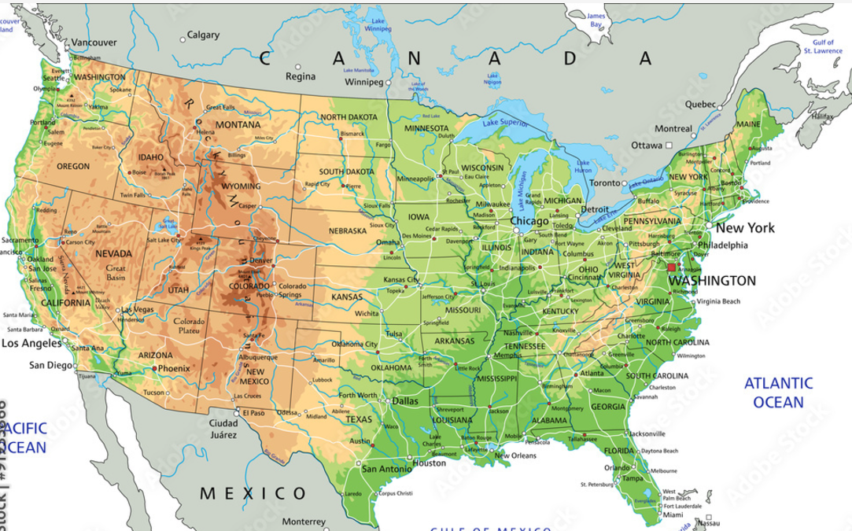
Recommendation III
Statewide Collaboration
Coordinate Efforts Across Regions
Ensure equitable distribution of charging infrastructure.
Collaborate with municipalities, utility providers, and local authorities.

Slide 12
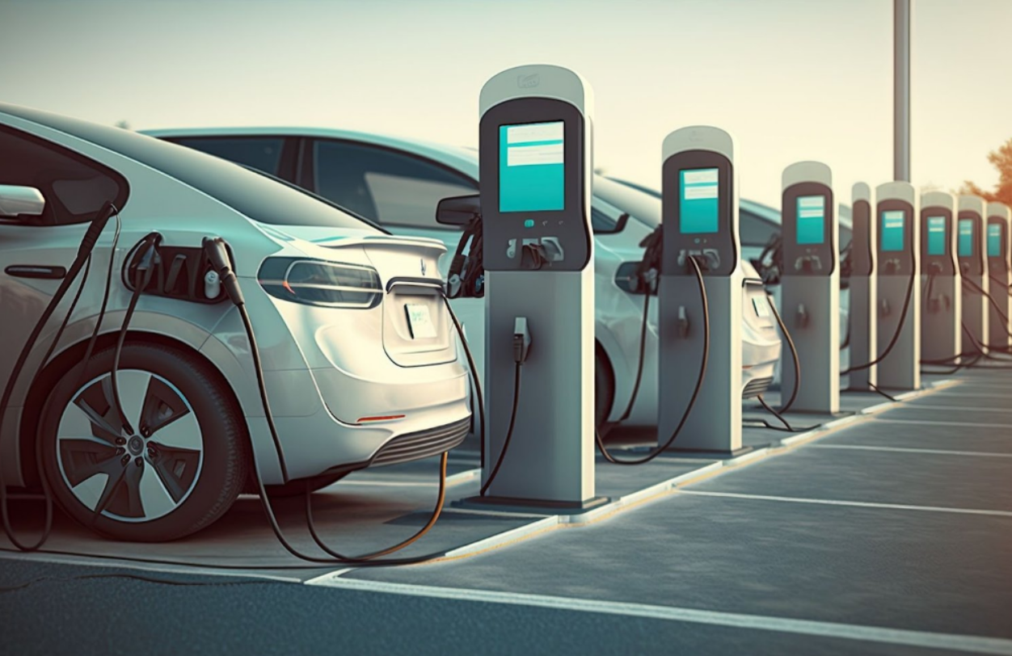
FUTURE WORK
I) Address Seasonal and Weather Impacts
Analyze how extreme weather conditions affect EV battery performance and charging demands.
II) Consider Socio-Economic Factors
Investigate patterns in EV adoption based on income, rural vs. urban locations, and access to transit.
III) Adopt a Multidisciplinary Approach
Collaborate with experts in transportation, urban planning, meteorology, and EV technology.
Study advancements in battery technology and their impact on future infrastructure needs.

Slide 13
Thank You

